Slide 1
AMAZON SALES ANALYSIS

Slide 2

INTRODUCTION
In today's fiercely competitive e-commerce landscape, effective sales management is crucial for businesses to thrive. As companies strive to reduce costs and increase profits, understanding sales trends and the factors influencing them becomes paramount. This project, titled "Analyzing Amazon Sales Data," aims to provide actionable insights into sales patterns, helping businesses optimize their sales strategies and improve overall performance.
By performing an ETL (Extract-Transform-Load) process on Amazon's sales dataset, we will analyze sales trends across various dimensions such as month-wise, year-wise, and yearly-month-wise. The analysis will not only reveal key metrics but also uncover meaningful relationships between different attributes, such as regions, product types, and sales channels.
This project leverages advanced data science techniques and tools, including Python, Tableau, and Power BI, to extract, transform, and analyze the data. The findings from this project will enable businesses to make data-driven decisions, enhancing their ability to meet customer demands, reduce costs, and ultimately boost profitability.

Slide 3

OBJECTIVE
The primary objective of this project is to analyze Amazon's sales data to uncover trends, identify key performance indicators (KPIs), and find meaningful relationships between different attributes of the dataset. The ultimate goal is to provide actionable insights that can inform strategic decision-making to enhance sales performance.

Slide 4
Main kpi’S
Total Revenue
Total Profit
Units Sold
Average Order Value
Profit Margin
Sales Growth Rate
Year-over-Year (YoY) Growth
Month-over-Month (MoM) Growth
Return on Investment (ROI)
Revenue per Region

Slide 5
POWER BI DASHBOARD
The project aims to analyze Amazon's sales data to uncover valuable insights and trends that can help optimize sales strategies. By leveraging Power BI, the project focuses on visualizing and interpreting sales trends, identifying key performance indicators (KPIs), and understanding the impact of various factors on sales performance.

Slide 6
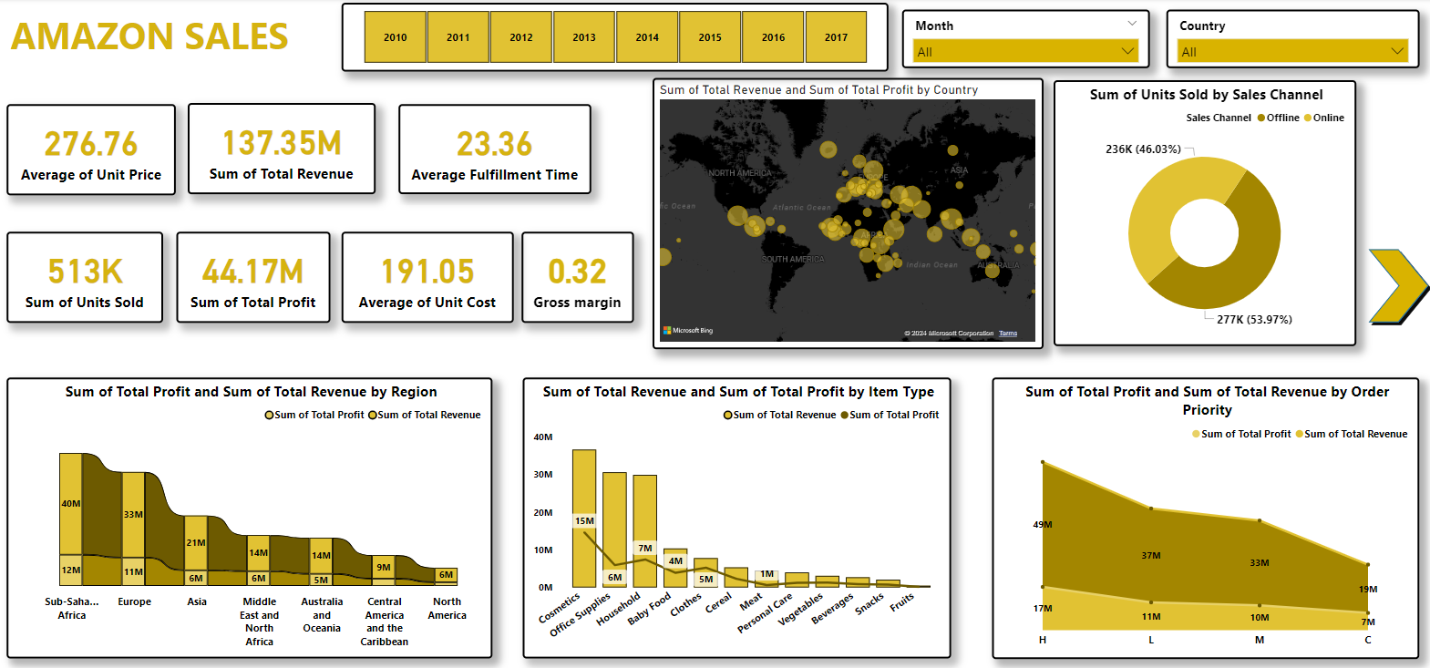

Slide 7
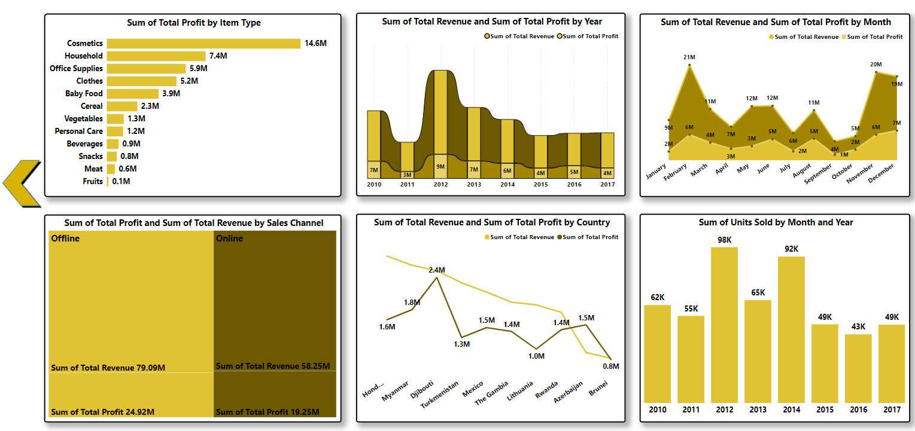

Slide 8
TABLEAU DASHBOARD
The goal of this project is to analyze and visualize Amazon's sales data to uncover trends, identify key performance indicators (KPIs), and reveal meaningful relationships between various attributes. The insights gained will help optimize sales strategies, improve distribution methods, and enhance profitability.

Slide 9
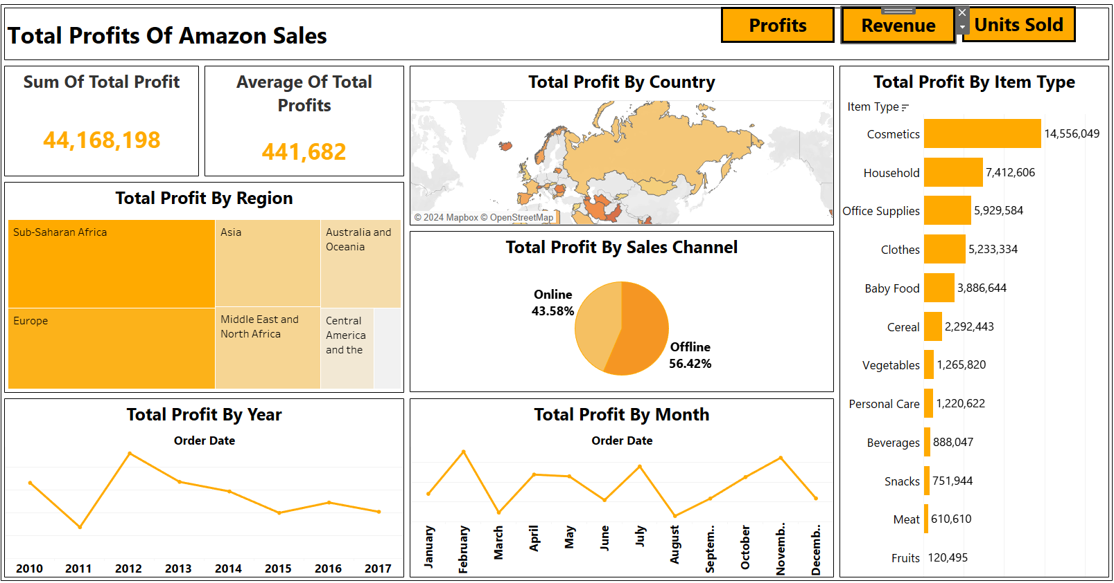

Slide 10
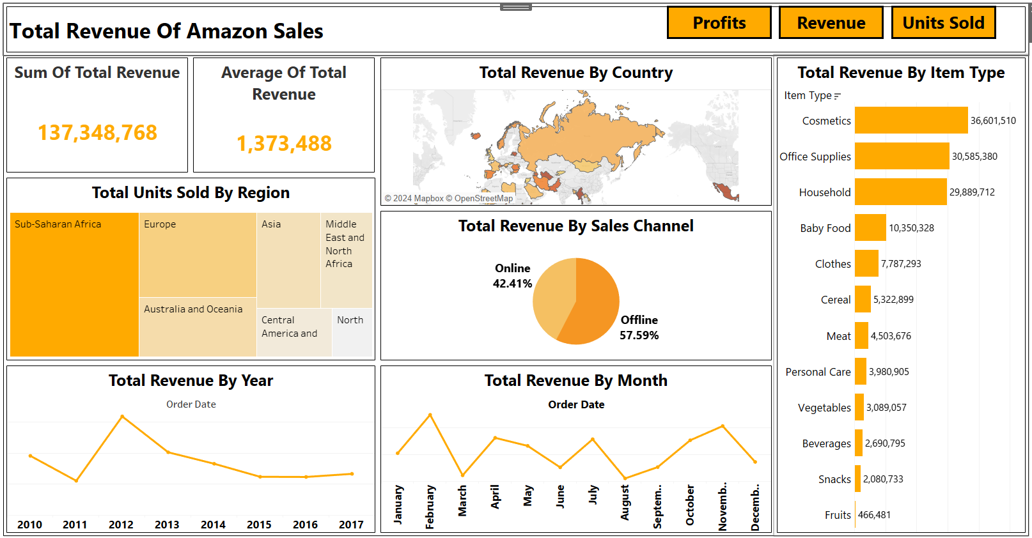

Slide 11
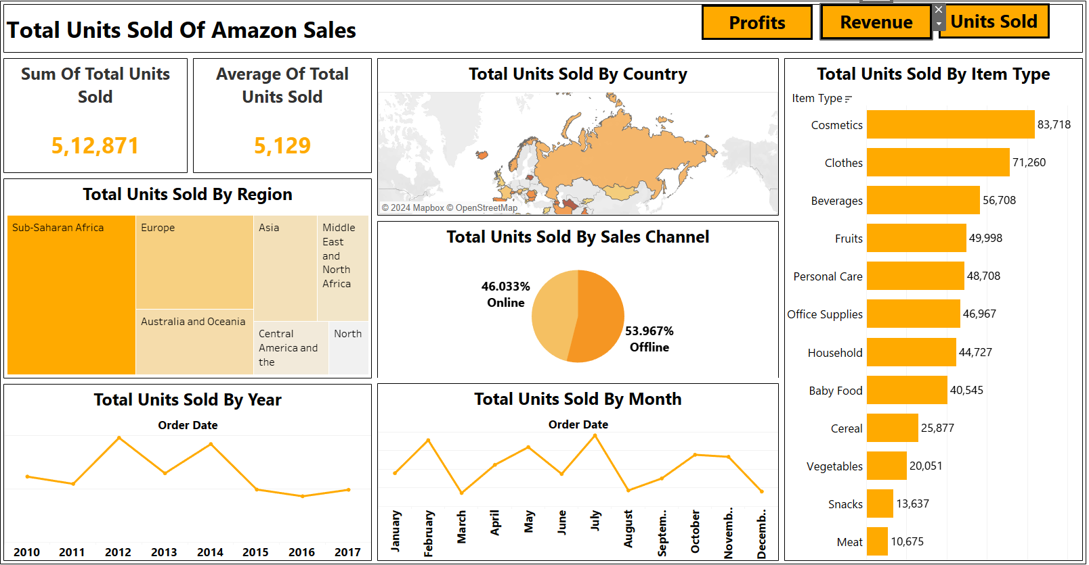

Slide 12
PYTHON
This Python-based analysis enables us to identify key sales trends, calculate essential KPIs, and explore the relationships between various attributes to optimize sales management strategies for better performance and profitability.

Slide 13
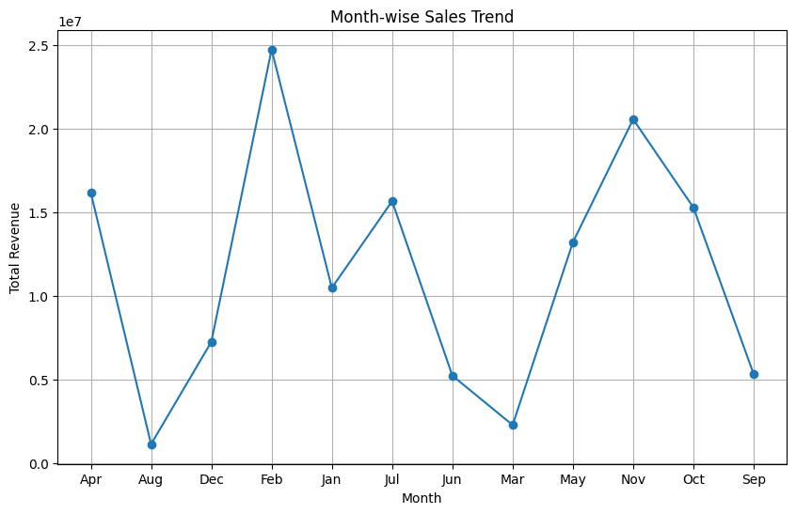

Slide 14
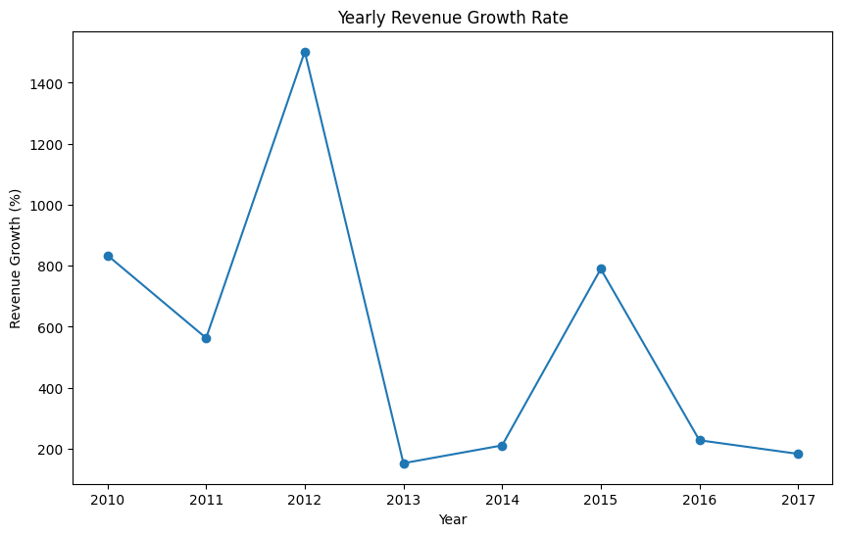

Slide 15
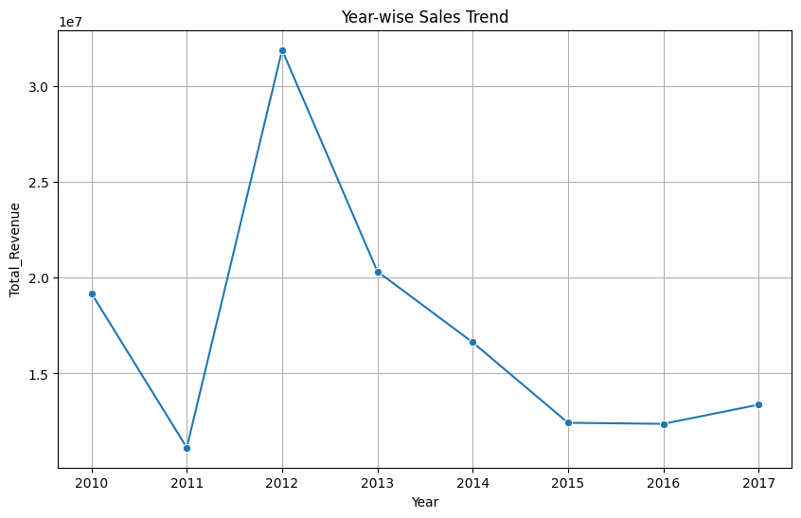

Slide 16
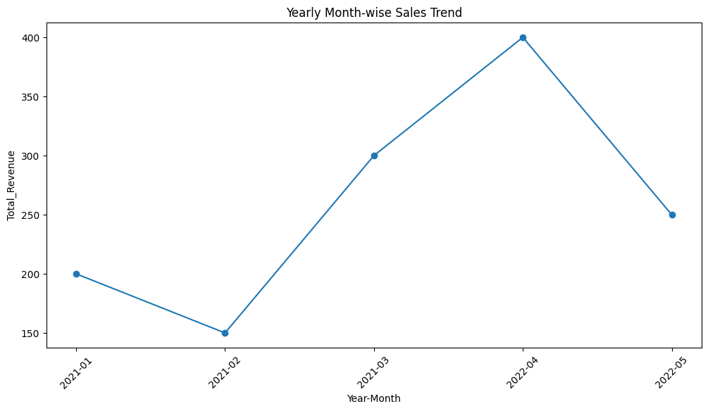

Slide 17
CONCLUSION
The analysis of Amazon sales data has provided valuable insights into sales trends, key performance indicators, and the factors that drive sales performance. By leveraging these insights, Amazon can optimize its sales strategies, enhance customer satisfaction, and ultimately increase profitability. The recommendations provided in this report offer actionable steps that can be implemented to achieve these goals.

Slide 18


VISIT FOR DETAILED PROJECT
Click on linkedin logo to visit my Profile
Click on Github logo to visit the portfolio of the project

Slide 19
THANK YOU

